Slide 1
Capstone Project
Coursera

Slide 2
Finding the Best Location for a Restaurant
The Project is to open a new restaurant in a specific location, which would be quite challenging as it requires a lot of capital investment upfront and many other factors. So it is important that all measures are taken to ensure that a restaurant is a success. One of the important factors that determine the success of a restaurant is it's location along with the quality of service and cuisines serviced in it

Slide 3
Business Problem
The report is going to focus on problems one might face while opening a new restaurant. Well there are many factors to be considered to open a small or big level business.
For example say Mr Paul wants to open a Indian restaurant, first and foremost important point to decide is the location for his new restaurant.

Slide 4
Business Problem(Contd)
1) On what basis can Paul decide his restaurant's location?
2) Does Paul want to rent the place or can he afford to buy it?
3) While selecting the place there are key points to consider like he needs to check out how many Indian restaurants are there in that specific location? If in-case there are already two Indian restaurants which have good ratings, will it be risky to open new one near these restaurants?
4) What all factors will help Paul to run his business above average?

Slide 5
Discussion
Firstly Paul needs to choose a suitable location for his restaurant. Let's say Paul wants to open a new Indian Restaurant in San Francisco. San Francisco is a famous tourist place, and also its in silicon valley, because of that real estate is very costly. So assuming that Paul wants to rent a place for his new restaurant. And now he needs to figure out how many restaurants are there in the neighborhood. If there are more than two Indian restaurants in a neighborhood then that would be a great risk to open new restaurant of same cuisine in that neighborhood.

Slide 6
Discussion (Contd)
Places like Downtown, Movie theatre, Malls & Gas stations would help his business running. Restaurants ratings, checking of customers might help in deciding location crowd. I would also suggest that Paul should check for opening and closing timings of othis restaurants. He may try opening his place 30 mins before other restaurants open up and close 30 mins or 1 hour later than other restaurants, this might help to get more customers

Slide 7
Data Collection
As Paul is planning to open a restaurant in San Francisco, and assuming that he is going to rent a place. So first I took the rent dataset from (https://web.archive.org/web/20180822060556/https://www.rentcafe.com/average-rent-market-trends/us/ca/san-francisco/ , https://www.zillow.com/research/data/) according to neighborhood wise, so that it's easy for us to check the rent data neighborhood wise.I have cleaned the dataset and I'm going to compare the rent data this year as we just need to analyze the current rent range.

Slide 8
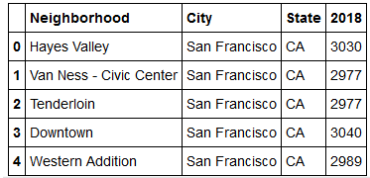
Screen shot of the collected DATA

Slide 9
Methodology
The formula to find which neighborhood is good to open a new restaurant.
FinalScore = (rentScore)0.6+(ratingScore)0.4 -> Closer the finalScore value to 1, better choice of neighborhood.
Rent Score= (maxrentofneighborhood-currentrentofneighborhood)/(maxrentofneighborhood-minrentofneighborhood)
RatingScore= (maxgoodrest-currentrestratingofN)/(maxgoodrest-mingoodrest).

Slide 10
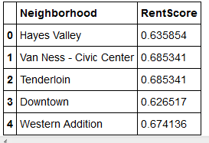
Methodology(Contd)
Based on these Formula, we can find the Max and Min Rent score.
maxrentofN = max(dataframename['rentcolumn']) minrentofN = min(dataframename['rentcolumn'])

Slide 11
Methodology(Contd)
Now, in order to calculate ratingScore, we need to retrieve rating of each Indian restaurant neighborhood-wise. So let's the analyze data. Firstly we need the co-ordinates of the neighborhood's, co-ordinates or latitude & longitude can be obtained by passing the Neighborhood name value through geocoding. The restaurant details can be retrieved using search endpoint of foursquare location

Slide 12
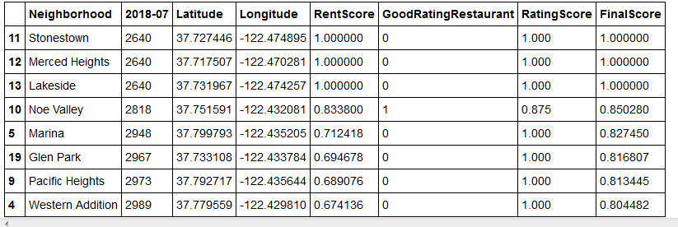
Result
Below is the result of my formula which I used to analyze best neighborhood's for new Indian restaurant. If you see carefully I have listed Neighborhood's which has Final score greater or equal to 0.8

Slide 13
Conclusion
Thus, Now Paul has more options to choose from. As there are 3 Neighborhood's in above results which are best suited for Paul and it looks like there is no heavy competition, since there is no good rating restaurants and rent is also comparatively low according to our formula.

